Slide 1
Key Considerations in Applied Text Analysis & NLP in I/O Psychology
4.5.2019
James Meaden & Cory Kind

Slide 2






Text Analysis Process
Figure adapted from Kobayashi et al., 2017
Preprocessing
Text Analyses
Postprocessing
Step 1
Identify need
Step 2
Data collection
Step 3
Data cleaning
Step 4
Transformation
Step 5
Analysis
Step 6
Interpretation & validation
What is the need?
Do we have the data?
Which elements to keep?
What data structure?
Which analytical technique?
Which reliability & validity metrics to us?
Notes:
Kobayashi (2017) had “apply domain knowledge” for: 1) text collection step (included research question in this step), 2) transformation, 3) pattern interpretation and evaluation

Slide 3
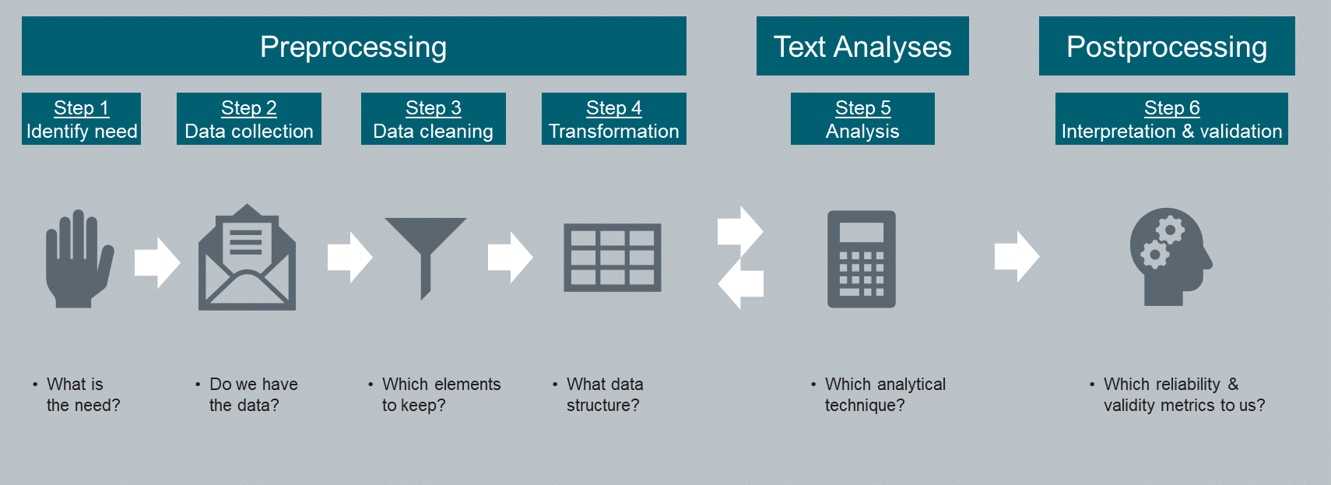
Preprocessing
Step 1. Identifying the need

Slide 4
Key Activities in Step 1
Write out the problem/opportunity statement
____________________________________________________________________________________
2. Define the scope of the project/NLP capability
____________________________________________________________________________________
3. Identify the goal(s) or target(s)
____________________________________________________________________________________
4. Document how success will be measured
____________________________________________________________________________________

Slide 5
Key Activities in Step 1
5. Identify key stakeholders: e.g., IT, legal, HR, …
____________________________________________________________________________________
6. Document required resources
Data: see table in main slide deck
Technology: (e.g., alignment with digital strategy, software needs)
____________________________________________________________________________________
7. Consider alternative (to NLP) approaches
Rate all options (including NLP) against all relevant criteria
E.g., expected ROI, risks (see slides in main deck), candidate experience, integration with other assessments/platforms…
__________________________________________________________________________________________________________________________________________________________

Slide 6
Preprocessing
Step 2. Data collection, storage, & management

Slide 7
Key Considerations (Data Already Exists)
How easy will it be to obtain the data?
_______________________________________________________________________________________________
2. For what reasons can the data be reused (legally, contractually)?
_______________________________________________________________________________________________
3. Beyond whether the data can be legally/contractually used, how will people (employees, candidates, customers) feel about their data being used in this way?
_______________________________________________________________________________________________
4. What format is the data in? What format can it be extracted into?
_______________________________________________________________________________________________
5. Are we able to merge this data with other (necessary) datasets?
_______________________________________________________________________________________________
6. What was the time period of collection? Is it appropriate?
_______________________________________________________________________________________________

Slide 8
Key Considerations (Data Already Exists)
7. What is the sample size, amount of text, amount of missing data?
_______________________________________________________________________________________________
8. What languages are represented in the dataset?*
_______________________________________________________________________________________________
9. What regions are represented in the dataset?*
_______________________________________________________________________________________________
10. What job levels/job families are represented in the dataset?*
_______________________________________________________________________________________________
11. Will you need a one-time extract or a continuous pulling of the data?
_______________________________________________________________________________________________
12. What was the prompt that generated the text responses?
_______________________________________________________________________________________________
* Is this representative of the whole organization, or at least the population in question?

Slide 9
Key Considerations (Data Needs to Be Collected)
Are we willing to invest in a new data collection effort?
_______________________________________________________________________________________________
2. What is the expected level of effort in collecting the data? _______________________________________________________________________________________________
3. What are the potential legal, contractual, and/or ethical issues?
_______________________________________________________________________________________________
4. Can the full population be reached? Or a sample? What is required?
_______________________________________________________________________________________________
5. How much of an emphasis should we place on the employee/candidate experience?
_______________________________________________________________________________________________
6. Which job levels should be assessed? For example, will a senior director respond to a lengthy text prompt?
_______________________________________________________________________________________________

Slide 10
Key Considerations (Data Needs to Be Collected)
7. Design of the questions:
a. How broad vs specific should the content of the responses be?
___________________________________________________________________________________________________________
b. How much time is allowed for each response?
___________________________________________________________________________________________________________
c. How much text should respondents produce?
___________________________________________________________________________________________________________
d. What should they consider/not consider when responding?
___________________________________________________________________________________________________________
e. Can what we are trying to measure be better captured with a Likert scale?
___________________________________________________________________________________________________________
f. How many open-text prompts are required?
___________________________________________________________________________________________________________
g. Do we think the prompts will stay the same over time or vary with each administration?
___________________________________________________________________________________________________________

Slide 11
Key Considerations (Data Needs to Be Collected)
8. How transparent should we be to respondents?
_______________________________________________________________________________________________
9. Should the open text items be administered with or separately from other items/assessments?
_______________________________________________________________________________________________
10. What devices might participants be using? How might this affect the design of the text prompt?
_______________________________________________________________________________________________
11. Could there be non-equal response rates? How could we avoid this? (e.g., certain ages, demographics, and technology/participation in surveys)
_______________________________________________________________________________________________
12. Do we want to be able to reuse this data? What other use cases should we try to enable?
_______________________________________________________________________________________________

Slide 12
Key Considerations (Data Needs to Be Collected)
13. Is the text prompt relevant to our use case?
_______________________________________________________________________________________________
14. Does this need to be predictive? If so, will you require predictive or concurrent validation?
_______________________________________________________________________________________________
15. From which time periods should the data be collected? Do you require multiple waves or a single point in time?
_______________________________________________________________________________________________
16. How will you connect responses to the individual and to other datasets (if necessary)?
_______________________________________________________________________________________________

Slide 13
Key Considerations (Data Storage)
1. Where will the data be stored?
____________________________________________________________________________
2. What anonymization method will you use?
____________________________________________________________________________
3. What are the legal requirements associated with the storage of this data?
____________________________________________________________________________

Slide 14
Key Considerations (Data Management)
Who will own the data?
____________________________________________________________________________
2. Who is responsible for working with cleaning, storing, or generating extracts?
____________________________________________________________________________
3. If you are using pre-existing data, who is managing the project(s) that the data currently supports?
____________________________________________________________________________
4. How else might the data used within the organization?
____________________________________________________________________________

Slide 15
Preprocessing
Step 3. Data cleaning

Slide 16
Key Considerations (Data Cleaning)
1. Should you remove stop words?
Keep stop words for short text (< 200 characters)
TF-IDF transformation enables the inclusion of stop words
Keep certain stop words for predicting personality (see Tausczik & Pennebaker, 2010)
_______________________________________________________________________________________________
2. Should you remove punctuation?
____________________________________________________________________________________
3. Should you use word stemming or lemmatization?
Possibly not if you are using a prebuilt dictionary
_______________________________________________________________________________________________
4. Should you correct misspelled words?
Possibly not if you are using a prebuilt dictionary
Can be prohibitive will larger datasets, difficult to automate
_______________________________________________________________________________________________

Slide 17
Preprocessing
Step 4. Transformation

Slide 18
Key Considerations (Transformation)
1. What structure do we want our data to be in? E.g., transform into DTM
____________________________________________________________________________________
2. What level of analysis: bag-of-words or “bag-of-phrases” model?
If bag-of-phrases, decide which N-grams to work with (e.g., bigrams, trigrams)
____________________________________________________________________________________
3. Do you need to normalize your features? (e.g., tf-idf)
____________________________________________________________________________________

Slide 19
Key Considerations (Transformation)
4. Will you generate additional variables from the text (“feature generation”)?
E.g., parts of speech, word complexity, readability, word count, language tagging
____________________________________________________________________________________
5. Will you need to reduce the number of variables (“feature reduction”)?
Dropping terms based on frequency of occurrence
Using a dictionary (existing or created)
Word stemming or lemmatization
____________________________________________________________________________________

Slide 20
Text Analyses
Step 5. Analysis

Slide 21
Key Considerations (Analyses)
1. What analyses will you use?
Supervised or unsupervised?
What specific methods might be relevant? (e.g., sentiment analysis, topic modeling)
____________________________________________________________________________
2. Against what metrics will you evaluate the results of your analyses?
Model performance: e.g., R-squared, precision, sensitivity
Practicality: e.g., importance of prediction versus “explainability”, speed of analysis
____________________________________________________________________________
3. What will your cross-validation methodology be?
E.g., in sample versus out of sample
____________________________________________________________________________
Notes:
Our CV strategy – LDA tuning
Some methods/analyses will have overlap with step 6 validation
E.g., BOW prediction model – the model is the criterion validation. Content and construct can then be assessed, as needed.

Slide 22
Postprocessing
Step 6. Interpretation & Validation

Slide 23
Key Considerations (Interpretation & Validation)
1. How will reliability be assessed?
____________________________________________________________________________________
2. How will validity be assessed?
____________________________________________________________________________________
3. How will you test for bias?
____________________________________________________________________________________

